Slide 1
Fall Statewide Meeting
October 1, 2026

Slide 2
Huge thank you to Waldport High School!

Slide 3
Grant Administration Updates
2026-2027 | Year 5

Slide 4

Year 5​
Amendments coming soon
Bus. Mangers will be notified
Superintendent review, approve, and sign​
Reimbursements processed after execution​
Agreement includes cost share obligations​

Slide 5
Reimbursement Processing Updates​
Internal system updates added additional review and scrutiny​
Additional questions may be directed to Bus. Managers​
Processing times may be longer ​
Funds remain available; delays are related to process changes​

Slide 6
New Federal Requirement​
Effective November 1, 2026:​
Written justification required for payment requests for all USDOE grant recipients
Documentation is already maintained​/required
Internal planning is underway with OSU​​

Slide 7
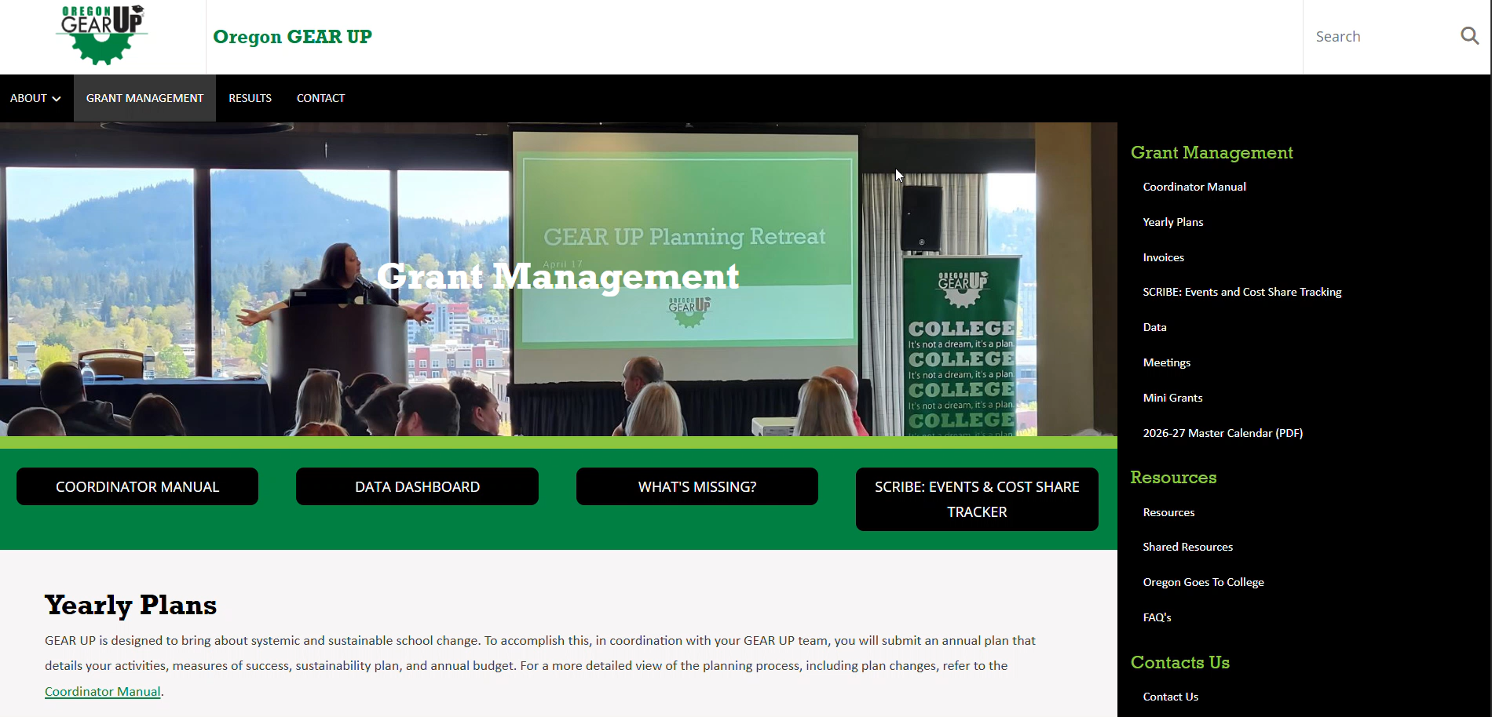
Grant Administration Communications​
Updates will be emailed to Bus. Managers, Admin., and Coor.
Fiscal Guide and policies are available on the Oregon GEAR UP website​
  living document and updated as changes occur​

Slide 8
Reimbursement Reminders​
Submit itemized receipts​
Documentation must demonstrate payment
​Understand which expenses paid by CO vs. grant

Slide 9
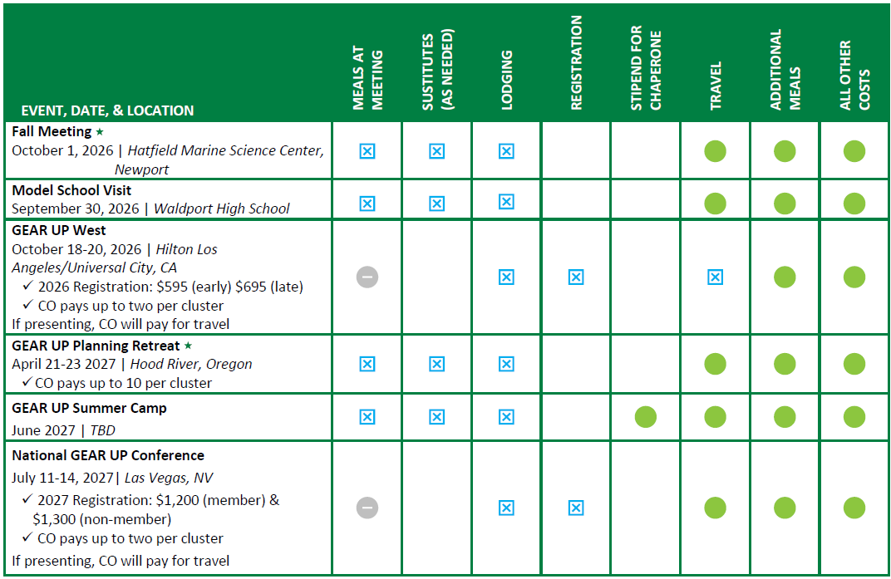
GEAR UP Upcoming Events

Slide 10

Allowable travel costs
District policy/federal per diem for meals​
Federal mileage rate​
Economy airfare​
Economy ground transportation​
One checked bag
Economy parking​
Rule of thumb - economically and no upgrades

Slide 11
Indirect Cost Update
Indirect costs can no longer be charged to Central Office paid expenses​ (4.3CO)
Applicable indirect amounts will be tracked for cost share​
Indirect costs remain allowable on subaward
Updated Expenditures Report available​

Slide 12
YAWP! Writing Platform Update
OSU requiring us to do Request for Proposals
Not a sole source
Timeline of RFP: 6 months – 1 year

Slide 13
Mini Grants
Cycle | Application Deadline | Applicant Notification By
October | October 31, 2026 | November 20, 2026
November | November 30, 2026 | December 20, 2026
December | December 31, 2026 | January 20, 2027
January | January 31, 2027 | February 20, 2027
February | February 28, 2027 | March 20, 2027
March | March 31, 2027 | April 20, 2027
April | April 30, 2027 | May 20, 2027
Now open!
Monthly review through April 2027 or until funds exhausted​
Applications due by 5:00 PM
Requests tied to activities within 30 days may not be funded​
Denied applications may be resubmitted​
Notifications issued 20 days after deadline​
Awards will be through DocuSign

Slide 14
Classroom Success Mini Grants​
Same as last year - ish
  Sustainable classroom initiatives
  New or expanded (not supplanting)
Consumables are allowed if connection with new project, program, or curriculum
  Required sustainability plan in application
Technology
  No 1:1 devices
  Not supplanting – only supplemental
  District IT approval required
Not allowable:
Salaries and benefits
Travel costs
Indirect costs or grant administration fees
Lobbying
Field trips or evening/weekend events
Tutoring
Generating profit (2 CFR §200.307)
Incentives
Entertainment/alcohol

Slide 15
Professional Development Mini Grants​
Schools, departments, or individuals
First-come, first-served funding​
Allowable: Extra-duty rate, substitutes, travel, facilitators, training materials, implementation materials and technology​
Not Allowed: Lobbying, field trips, tutoring, incentives, entertainment/alcohol, indirect costs​, generating profit
Funds must supplement, not supplant

Slide 16
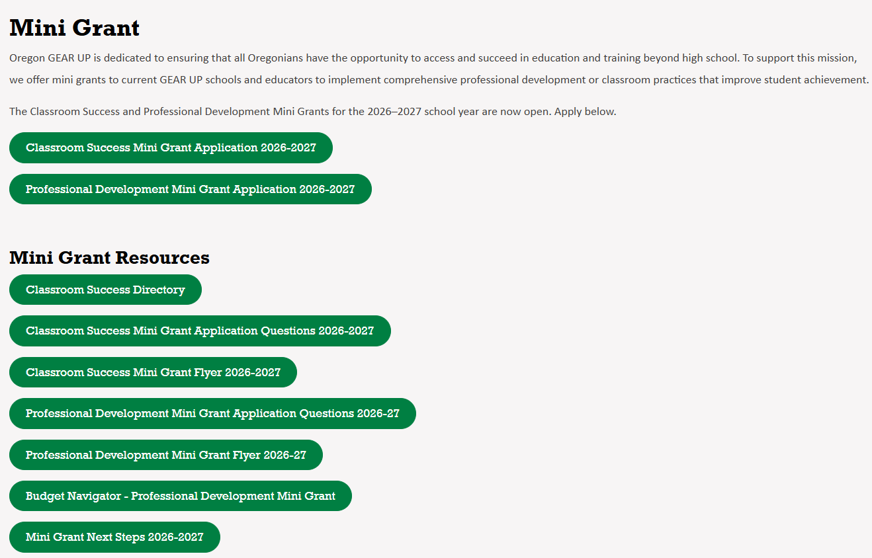

Slide 17

Now available!
HECPS Curriculum
  Seeking Assistance & Self-Advocacy
  Career Exploration & Preparation
  Postsecondary Readiness
  Workforce Readiness
60 hours/60 frameworks
Assessment ideas
Extension activities
Supplemental resources
Printed versions, coming your way

Slide 18
Questions?

Slide 19
TRUE CONFESSIONS
Bridgit Montgomery-Coordinator of Statewide Services
Notes:
How to Use This Table
Branding: Do not copy-paste tables from other decks; use this one to keep our fonts and colors consistent.
Accessibility (WCAG): Keep the Header Row checked in the 'Table Design' tab.
Avoid merging or splitting cells (it confuses screen readers).
Open the ‘Accessibility’ tab > select ‘Alt Text’ to add a brief description of the data.
Summarize, Don't Duplicate: The Alt Text should describe the purpose and trend of the table, not every single cell.

Slide 20
How do we play:
Just like the game show on Jimmy Fallon Late Night we are going to play 2 session of True Confessions. Pick Clue 1 or 2 (one is true, one is false), you have 1 minute to ask questions, and then you decide if it is true or false
THEME:
HIGH SCHOOL COLLEGE GOING CULTURE
Notes:
How to Use This Table
Branding: Do not copy-paste tables from other decks; use this one to keep our fonts and colors consistent.
Accessibility (WCAG): Keep the Header Row checked in the 'Table Design' tab.
Avoid merging or splitting cells (it confuses screen readers).
Open the ‘Accessibility’ tab > select ‘Alt Text’ to add a brief description of the data.
Summarize, Don't Duplicate: The Alt Text should describe the purpose and trend of the table, not every single cell.

Slide 21
Round 1:
Bridgit
Statements 1:
My counselor told my mom that I would never graduate from college​
Notes:
How to Use This Table
Branding: Do not copy-paste tables from other decks; use this one to keep our fonts and colors consistent.
Accessibility (WCAG): Keep the Header Row checked in the 'Table Design' tab.
Avoid merging or splitting cells (it confuses screen readers).
Open the ‘Accessibility’ tab > select ‘Alt Text’ to add a brief description of the data.
Summarize, Don't Duplicate: The Alt Text should describe the purpose and trend of the table, not every single cell.

Slide 22
Round 1:
Bridgit
Statements 2:
My high school Ag Teacher took me on a college visit
Notes:
How to Use This Table
Branding: Do not copy-paste tables from other decks; use this one to keep our fonts and colors consistent.
Accessibility (WCAG): Keep the Header Row checked in the 'Table Design' tab.
Avoid merging or splitting cells (it confuses screen readers).
Open the ‘Accessibility’ tab > select ‘Alt Text’ to add a brief description of the data.
Summarize, Don't Duplicate: The Alt Text should describe the purpose and trend of the table, not every single cell.

Slide 23
INTEROGATION
Bridgit Montgomery-Coordinator of Statewide Services
Notes:
How to Use This Table
Branding: Do not copy-paste tables from other decks; use this one to keep our fonts and colors consistent.
Accessibility (WCAG): Keep the Header Row checked in the 'Table Design' tab.
Avoid merging or splitting cells (it confuses screen readers).
Open the ‘Accessibility’ tab > select ‘Alt Text’ to add a brief description of the data.
Summarize, Don't Duplicate: The Alt Text should describe the purpose and trend of the table, not every single cell.

Slide 24
Round 2:
Find a partner (someone you don't usually talk too)
2 Statements:
You will have 1 minutes to think of statements
  1 must be true and 1 must be false
Share your statement with your partner
  They get 1 minute to interrogate you
After 1 minute, decide if the statement is true or false
REPEAT
Notes:
How to Use This Table
Branding: Do not copy-paste tables from other decks; use this one to keep our fonts and colors consistent.
Accessibility (WCAG): Keep the Header Row checked in the 'Table Design' tab.
Avoid merging or splitting cells (it confuses screen readers).
Open the ‘Accessibility’ tab > select ‘Alt Text’ to add a brief description of the data.
Summarize, Don't Duplicate: The Alt Text should describe the purpose and trend of the table, not every single cell.

Slide 25
COLLEGE GOING CULTURE
Bridgit Montgomery-Coordinator of Statewide Services
Notes:
How to Use This Table
Branding: Do not copy-paste tables from other decks; use this one to keep our fonts and colors consistent.
Accessibility (WCAG): Keep the Header Row checked in the 'Table Design' tab.
Avoid merging or splitting cells (it confuses screen readers).
Open the ‘Accessibility’ tab > select ‘Alt Text’ to add a brief description of the data.
Summarize, Don't Duplicate: The Alt Text should describe the purpose and trend of the table, not every single cell.

Slide 26
Think about:
What truths do we tell ourselves about our school culture?
What lies do we tell ourselves about our schools culture?
Notes:
How to Use This Table
Branding: Do not copy-paste tables from other decks; use this one to keep our fonts and colors consistent.
Accessibility (WCAG): Keep the Header Row checked in the 'Table Design' tab.
Avoid merging or splitting cells (it confuses screen readers).
Open the ‘Accessibility’ tab > select ‘Alt Text’ to add a brief description of the data.
Summarize, Don't Duplicate: The Alt Text should describe the purpose and trend of the table, not every single cell.

Slide 27
Question:
Now that you are thought about what your high school experience compare it to where you are now. Take 1 ½ minutes and answer the following:
Does your High School have a strong College Going Culture? What could we improve?
Notes:
How to Use This Table
Branding: Do not copy-paste tables from other decks; use this one to keep our fonts and colors consistent.
Accessibility (WCAG): Keep the Header Row checked in the 'Table Design' tab.
Avoid merging or splitting cells (it confuses screen readers).
Open the ‘Accessibility’ tab > select ‘Alt Text’ to add a brief description of the data.
Summarize, Don't Duplicate: The Alt Text should describe the purpose and trend of the table, not every single cell.

Slide 28
Discussion:
2 minutes to think
3 mins and talk with the people at your table about your current College Going Culture.
Notes:
How to Use This Table
Branding: Do not copy-paste tables from other decks; use this one to keep our fonts and colors consistent.
Accessibility (WCAG): Keep the Header Row checked in the 'Table Design' tab.
Avoid merging or splitting cells (it confuses screen readers).
Open the ‘Accessibility’ tab > select ‘Alt Text’ to add a brief description of the data.
Summarize, Don't Duplicate: The Alt Text should describe the purpose and trend of the table, not every single cell.

Slide 29
4 Corners:
Why it matters?
Pick a Corner:
Which of the following is the most important for you (pick a corner)?
    I believe you have to have staff buy-in to create a college going culture
    I believe the best way to create a college going culture is Communication. What we say at school, information to families, and how peers talk to peers
    I believe that visuals displays, posters, pennants, etc. around the school is the most effective way to create a college going culture mindset with students and families
    I believe creating events such as College Application Week, Decision Day, and Spring Into Action, are the most effective way to get students and families involved in creating a college going culture
Notes:
How to Use This Table
Branding: Do not copy-paste tables from other decks; use this one to keep our fonts and colors consistent.
Accessibility (WCAG): Keep the Header Row checked in the 'Table Design' tab.
Avoid merging or splitting cells (it confuses screen readers).
Open the ‘Accessibility’ tab > select ‘Alt Text’ to add a brief description of the data.
Summarize, Don't Duplicate: The Alt Text should describe the purpose and trend of the table, not every single cell.

Slide 30
Discussion:
Take 3 minutes and talk with the people at your corner about their why you chose that statement, then write on the post it some of the reasons why
Walk about:
Take 2 minutes and walk around view the other Post it's, then head back to your table
Notes:
How to Use This Table
Branding: Do not copy-paste tables from other decks; use this one to keep our fonts and colors consistent.
Accessibility (WCAG): Keep the Header Row checked in the 'Table Design' tab.
Avoid merging or splitting cells (it confuses screen readers).
Open the ‘Accessibility’ tab > select ‘Alt Text’ to add a brief description of the data.
Summarize, Don't Duplicate: The Alt Text should describe the purpose and trend of the table, not every single cell.

Slide 31
Creating a Mission for your school
Discussion Questions:
What are our strengths
Where can we improve
Discussion:
With your team create a Mission statement with 4 goals on how you will increase your current College Going Culture and make it stronger
**College-Going Culture Toolkit
Notes:
How to Use This Table
Branding: Do not copy-paste tables from other decks; use this one to keep our fonts and colors consistent.
Accessibility (WCAG): Keep the Header Row checked in the 'Table Design' tab.
Avoid merging or splitting cells (it confuses screen readers).
Open the ‘Accessibility’ tab > select ‘Alt Text’ to add a brief description of the data.
Summarize, Don't Duplicate: The Alt Text should describe the purpose and trend of the table, not every single cell.

Slide 32
Think about:
Oregon Goes To College
College going Culture Toollkit
  Why a college-going culture matters
  What is a college-going culture?
  Assessing your school's culture
  What you believe
  What you say
  What you see
  What you do
Notes:
How to Use This Table
Branding: Do not copy-paste tables from other decks; use this one to keep our fonts and colors consistent.
Accessibility (WCAG): Keep the Header Row checked in the 'Table Design' tab.
Avoid merging or splitting cells (it confuses screen readers).
Open the ‘Accessibility’ tab > select ‘Alt Text’ to add a brief description of the data.
Summarize, Don't Duplicate: The Alt Text should describe the purpose and trend of the table, not every single cell.

Slide 33


Questions?

Slide 34
Sustainability
Year 5 and Beyond

Slide 35
Objectives
Identify highest-impact GEAR UP Activities
Review research and outcome data
Assess current partnerships
Explore future partnerships/funding opportunities
Build sustainability plan
  1 Activity
  1 Innovation

Slide 36
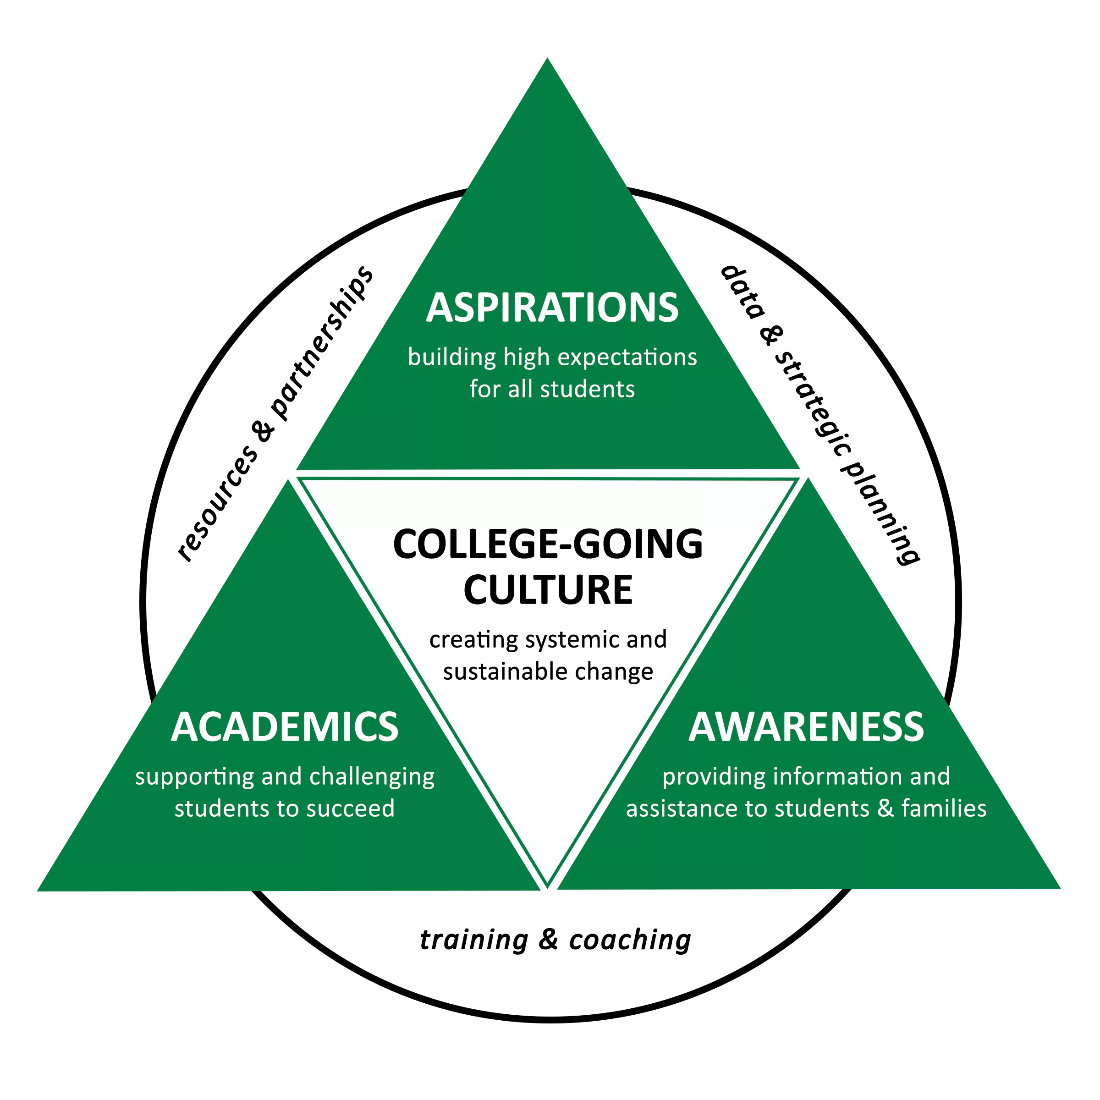
Notes:
In just a moment, each of you will receive a longitudinal plan overview, identifying activities from your plan for Years 2-5. Each activity is aligned to one of the 3 A’s, research-based principles that outline our theory of change model: Academics, Aspirations, and Awareness.
In your school teams, we are going to spend some time reviewing our plan activities through a college going culture lens: Not ‘did we do this’, but rather ‘what was the real impact’- did this in fact build/grow our college going culture?
You will also note there are sections for activities present in all four years, a note about when activities were added/dropped, and some overall program notes including emerging priorities. Please know, AI was helpful in this process, so review sections with a grain of salt ☺

Slide 37

Looking across Years 1-5, which activities do you believe most directly built or strengthened a college-going culture at your school? What did you use as your measure of success (i.e. attendance, staff buy-in, student/family feedback, other data you've seen)?
Discussion Questions
As you review your list, are there any activities that feel more like checking a box than impacting a culture-shift? What was missing?
Are there patterns across your five years and/or is your impact concentrated in one or two of the 3 A's (heavy on Awareness, light on Aspirations)?
Notes:
20 Minutes

Slide 38

5
TOP
Impact Statement
1 per team member
#GEARUPworks
Succinct (5-10 Words)
Neat
Colorful
Notes:
Now that you have had a chance to review your plan activities, take a few moments to narrow to your top 5 highest-impact activities. Once identified, write in rank order on the chart paper provided- we’ll be coming back to these here shortly.
Then, in continued celebration of national GEAR UP week, each team member is going to select one of your top five activities to write a clear, succinct impact statement, tagging #GEARUPworks.
As the goal is to later post these on socials, on your index card, please include the #, keep it succinct (5-10 words), use your nice handwriting ☺, and make it colorful.

Slide 39
Research Says…
Notes:
Thinking long term and toward sustainability, now that we have identified what we feel are the highest impact activities, we’re going to take a look at what the research says.

Slide 40
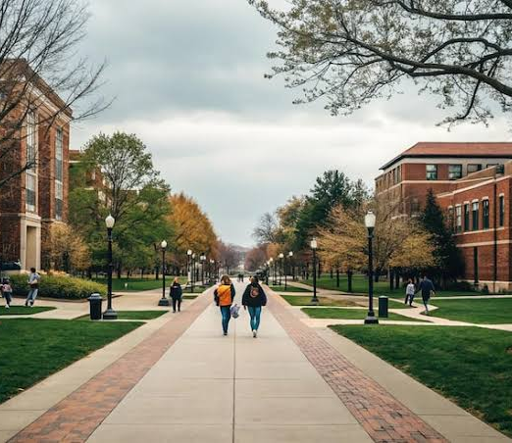
Oregon GEAR UP Outcomes
51% of graduates enrolled in college between 2020-2025
Persistence rates ranged between 79-81%
Metis Associates
Notes:
To identify what best predicted college enrollment and persistence rates, Metis Associates conducted a five-year follow-up study following the Class of 2020 representing 28 Schools from 16 Rural Communities and here is what they found:
51% of graduates enrolled in college sometime between 2020 and 2025.
Persistence rates ranged between 79-81%

Slide 41
Enrollment: Positive Predictors
Hours spent on college campus visits/shadowing
Hours spent on educational field trips
Hours spent on tutoring/HW assistance
Average daily attendance
Demographic Factors
Metis Associates
Notes:
After controlling for demographics and school factors, significant positive predictors of college enrollment included:
Hours spent on college campus visits/shadowing — each additional hour raised a student's likelihood of enrolling by about 9%
Hours spent on educational field trips — about +8% per hour
Hours spent on tutoring/homework assistance — about +6% per hour
Average daily attendance — each 1-point increase in attendance raised the odds of enrolling by about 6%
Worth Noting:
Female students were about twice as likely to enroll as male students
And students in special education were about half as likely

Slide 42
Persistence: Positive Predictors
Enrollment in a 4-Year Institution
  Students who enrolled in a 4-year v. 2-year post-secondary program were nearly 5x more likely to continue
Senior Year Average Daily Attendance
8th Grade Math Scores
Metis Associates
Notes:
Significant positive predictors of college persistence once enrolled:
Enrolling in a 4-year institution — students were nearly 5x more likely to persist than those in 2-year programs
Average daily attendance (senior year) and 8th-grade math scores were also significant positive predictors

Slide 43

National Outcomes
Near-Peer Mentoring
  Structured & Sustained
Mentoring
  Better attendance
  Positive attitude
GEAR UP Comprehensive Models
College & Career Readiness Evaluation Consortium (CCREC)
Notes:
The College & Career Readiness Consortium, otherwise known as CCREC, identified the following activities as having a positive influence on college-going culture:
Structured, sustained near-peer mentoring- thinking older students, recent college grads- is associated with measurable enrollment gains
One state study found high schools with near-peer mentoring saw about a 4-point increase in college enrollment in year one with an even larger effect size (~6 points) for male students.
Mentoring relationships broadly (not just near-peer) are linked to substantially higher likelihood of college enrollment for students facing opportunity gaps, plus better attendance and more positive attitudes toward school.
GEAR UP-style comprehensive models- thinking advising, mentoring, tutoring, financial aid navigation, parent engagement etc. is linked to gains in readiness, graduation, and enrollment

Slide 44
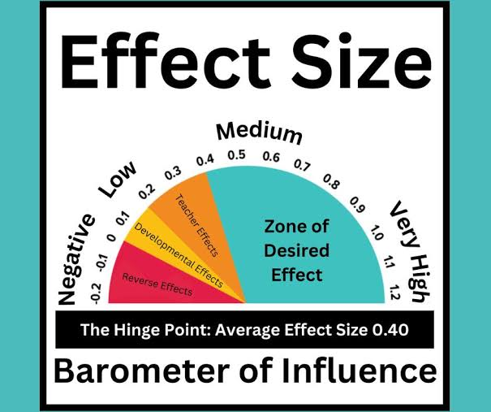
Hattie’s Visible Learning Outcomes
Anything with an effect sizes > 0.40 is considered to have an above-average influence on outcomes
John Hattie
Notes:
And lastly, looking at Hattie’s Visible Learning Effect Sizes (*included because I love his research, and there is a direct correlation between the aim of GEAR UP and its long-term impact on your schools)…
Here, anything with an effect size above 0.40 is considered to have an above-average influence on outcomes.

Slide 45
Hattie’s Visible Learning Outcomes
Collective Teacher Efficacy: 1.57
  Staff’s shared belief they can affect outcomes
Teacher Credibility: .90
Students’ Self-Efficacy: .92
Teacher/Student Relationships: .72
Structured Peer Teaching: 1.20
John Hattie
Notes:
According to Hattie:
Collective Teacher Efficacy, or in other words, staff’s shared belief they can affect outcomes has 1.57 effect size
Teacher Credibility: .90 effect size
Students’ Self Efficacy- a student’s belief in their own capability- has a .92 effect size. Thinking activities that build students’ confidence/sense of self v. information delivery
Student/Teacher Relationships has an effect size of .72- Thinking of the student survey data point that reveals their perception of staff support/belief in their abilities.
And the last data point here, reaffirming the impact of mentor/mentee relationships- structured peer-teaching has a 1.20 effect size.

Slide 46
Review…
Notes:
So now that we have seen the research, as a school team, we are going to revisit our top five…

Slide 47
How/where do your identified top 5 align with the research? Where does it diverge?
If it diverges, do you want to keep it on your list? What does that tell you about your community?
Discussion Questions
As a school, is there anything you are doing well that isn’t reflected in your GEAR UP plan, but you feel is positively impacting your college-going culture? If so, add to your list.
Moving into the final years of the grant, where do you want to prioritize your sustainability efforts (*)? What might you want to add/emphasize for Years 5-7? Add to your list.
Notes:
Please take about 10 minutes to discuss the following:
How/where do your identified top 5 align with the research? Where does it diverge?
If it diverges, do you want to keep it on your list? What does that tell you about your community?
As a school, is there anything you are doing well that isn’t reflected in your GEAR UP plan, but you feel is positively impacting your college-going culture? If so, add to your list.
Moving into the final years of the grant, where do you want to prioritize your sustainability efforts (*)? What might you want to add/emphasize for Years 5-7? Add to your list.
After you have had a chance to refine your list, we will have the opportunity to hear what others are thinking, but for now,10 minutes on the clock.

Slide 48

Gallery Walk
School Teams
  Assign a ‘Host’ for both rotations
      Top 5+
      Selection Criteria
      Prioritized Sustainability
      Questions
Team Members
  Divide and conquer
  Two, 8 Minute Rotations
  Gather insight, ask questions
Notes:
Now that you have refined your own lists, we wanted to give you an opportunity to connect with the other schools in the room. With attention to time, we will only have two rounds, so divide and conquer among your school teams.
Format:
Assign one person to stay at your table (*They will be the ‘host’ for both rotations)
All other team members will travel to a new school where the ‘host’ will share:
Their list of priorities?
Their selection/impact criteria?
Where they plan to prioritize sustainability?
Answer any questions…
Rounds will last approximately 8 minutes, and then we will reconvene…

Slide 49
1
Planning Ahead…
For Year 6, identify one activity you will commit to sustaining without the use of GU Funds
Sticky Note:
  School
  Name of Activity
Notes:
As members return to their school teams, what is one key takeaway? Something you might add to your list? Something you hadn’t considered in your conversation? A new idea? A refinement?
And then, being intentional about our efforts, as a team decide on one activity you can commit to sustaining next year without the use of GEAR UP Funds? Write your school and Activity Name, and then we will come around to collect these.

Slide 50
Partnerships
Notes:
As you look back through your Plan Crosswalks, on the final page you will see an inventory of existing partners. Please note, this is not a comprehensive list of all school partnerships, so there is an ‘Other’ section for any you would like to add or include in today’s conversation.
Again, with an eye toward sustainability, we know some activities can be built into our building budgets, but others may lean on these relationships/programs/people after grant funding ends, so as we start our conversation, it is worth reflecting on what is happening now.

Slide 51
Review your list. Of the partners on your list, which relationships are genuinely active and mutually beneficial right now? Are there any missing?
Discussion Questions
Are there partnerships that started strong but have faded? What would it realistically take to reactivate them?
Where do you see room to deepen rather than just maintain a partnership?
    For example, moving from a one-time guest speaker to a structured internship or job-shadow pipeline, or from in-kind support to an actual funding commitment?
Code Activities: Grow Maintain Change/Reactivate Cancel
Notes:
Discussion Questions:
Of the partners on your list, which relationships are genuinely active and mutually beneficial right now — not just on paper?
Are there partnerships that started strong but have faded? What would it realistically take to reactivate one of them?
Where do you see room to deepen rather than just maintain a partnership — for example, moving from a one-time guest speaker to a structured internship or job-shadow pipeline, or from in-kind support to an actual funding commitment?
Code as you go…

Slide 52
Bucket List
Healthcare (Hospitals, Clinics, CTE Pathways)
Rotary/Chamber of Commerce
Higher Ed
Local ESD
Local Industry/Major Employers
Small Business Associations
Public Safety (Police/Fire/EMS)
OSU Extension Services
FFA/4H/County Fair Boards
Farm Bureau
Credit Unions/Community Banks
Tribal Partnerships
Faith-based Organizations
Local Media Stations
Alumni Networks
Workforce Development Board (WorkSource Oregon)
Notes:
We all know time is a limited commodity, and we don’t often have the luxury to explore what else is out there.
For that reason, we wanted to dedicate some time today to explore/research ideas for New Partnerships in your town, in your community, potentially even in your general region.
Listed here are some general categories for exploring. Take a quick minute to review what’s here, and if you can think of any to add to the list, let’s get them up here.

Slide 53

Research Questions
Task
Where do you have existing relationships?
Are there new opportunities?
SEARCH/EXPLORE What can you find?
Are there existing regional consortiums/school partnerships you can plug into?
Available funding/grant opportunities?
As a team, identify one innovative partnership idea you want to pursue:
Who is the single best point of contact?
What is your vision?
What is your ask?
Who will be responsible for next steps?
Notes:
For the next 30 minutes or so, decide with your team how you want to tackle this list.
I’ve put up some guiding research questions for you, but ultimately your goal is to take this time to see what kind of new/innovative partnerships might be available to you and then, develop an action plan for prioritizing/taking next steps.
By the end of the 30 minutes, I would like each team to have identified one, specific, innovative partnership idea you want to pursue when you walk out of the room today with a basic action plan you are going to share with the whole group.
*Come back together- round robin share out.
Each team shares their one innovative partnership idea in 60 seconds or less — no discussion, just share and move on. Consider having someone jot these on a shared doc/chart paper so every school leaves with the full list, not just their own idea.

Slide 54
Promising Practice
We look forward to hearing from you…
Notes:
Looking ahead to the Planning Retreat, this year each school’s Promising Practice will center on your school’s innovative partnership idea. Ideally, it is the one you shared with the group today, but if that falls flat, we are asking that you find and pursue one where you can find success. There will be more instruction around that to come, but for our GEAR UP Coordinators, that is your HW… to bring idea into fruition for meaningful gains/sustainability over time.

Slide 55
One Word + One Commitment
As a team, write one word to summarize how you feel about sustainability planning?
Based on our work together today, commit to one concrete action step your team will take in the next month.
Closing
Notes:
Closing
On your chart paper:
As a team, write one word to summarize how you feel about sustainability planning?
Based on our work together today, commit to one concrete action step your team will take in the next month.

Slide 56
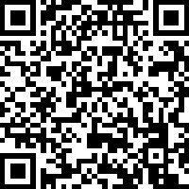
Take the survey!
Your feedback is appreciated.
bit.ly/3TAW25E
Notes:
[Ash will need to test QR on screen during slideshow and adjust as needed (as of 4/20 QR code works –AR)]
Take the survey!
(Provide the audience a reason why they need to take the survey and are sticking around)

