Slide 1
What is Rigor?
Oregon GEAR UP Professional Development for Educators

Slide 2
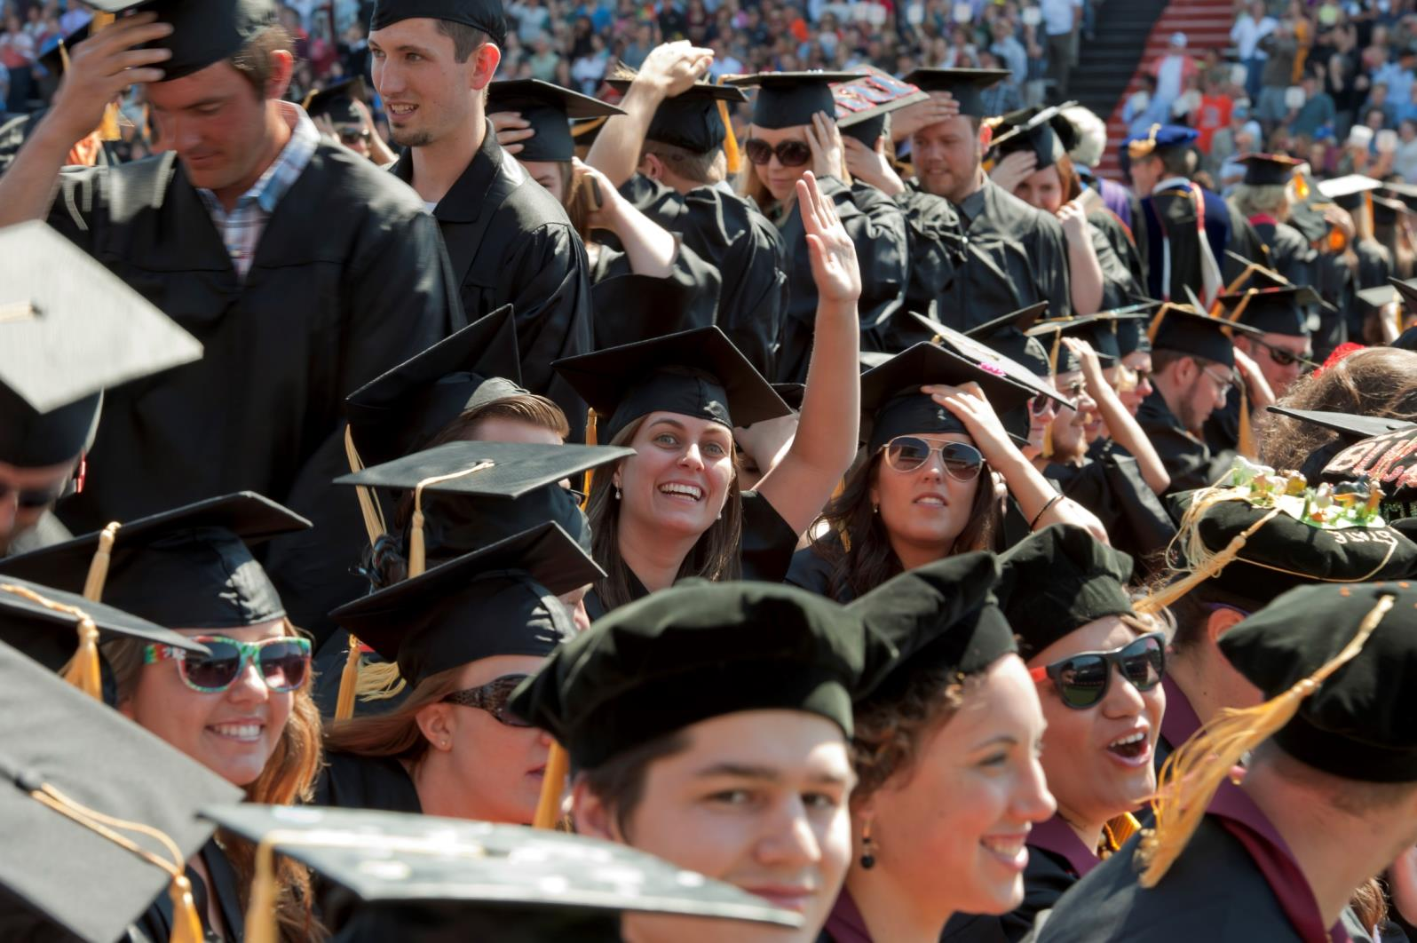
COLLEGE
It’s not a dream, it’s a plan.
Notes:
Oregon GEAR UP is a federally-funded program that seeks to increase the numbers of low-income students who enter and succeed in postsecondary education.
As a GEAR UP school, we receive funding, technical assistance and other support to change the culture in our school and community to one that promotes college*-going for all students.
*Note: Oregon GEAR UP defines “college” as any type of education or training after high school – community college, 4-year universities, apprenticeships, job training.

Slide 3
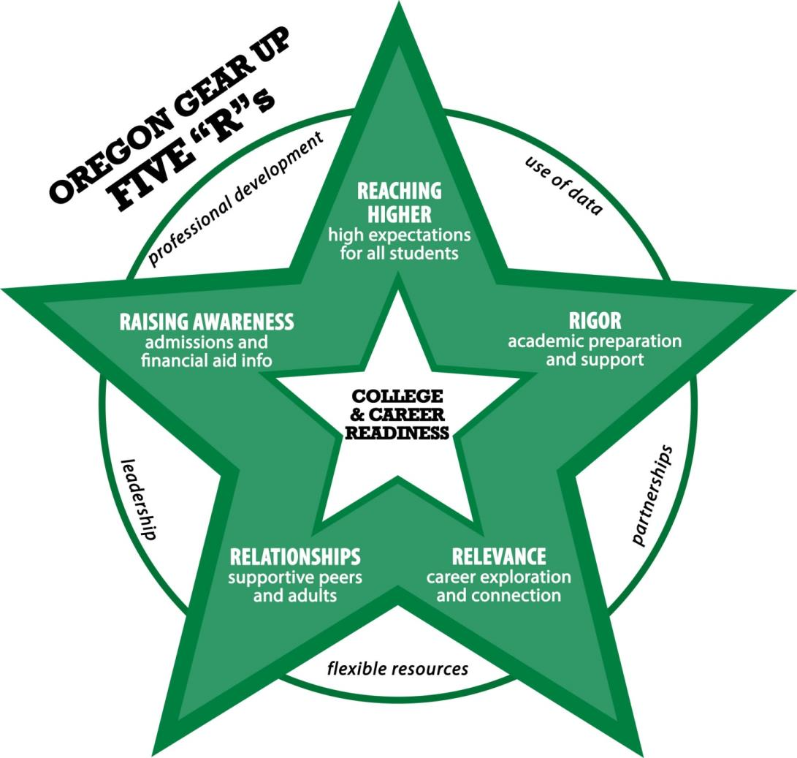
GEAR UP’s Model
Notes:
A refresher on GEAR UP’s research-based model – briefly review the 5 R’s.
Today, we’re going to be focusing on the three components of rigor and how they impact student learning.

Slide 4
How do you define rigor? What does it look like in your classroom? In our school?
^
Notes:
5-10 minutes for discussion.
Depending on the size of the group, you may want to encourage small groups to discuss and then share out to a larger group.

Slide 5
Notes:
5-10 minutes
Read Rigorous Schools & Classrooms research brief.

Slide 6
How does this part of the definition apply at our school? What are we currently doing at our school that reflects this part of the definition?
^
Notes:
10-15 minutes
Assign each of the three groups one part of the definition described in the brief: 1) expecting students to learn at high levels, 2) supporting students to learn at high levels and 3) ensuring students demonstrate learning at high levels
Ask each group to discuss and record their response to the questions.

Slide 7
Summarize the expectations of college attainment for each group surveyed (students, educators and parents). What, if anything, surprised you? What strategies or messaging would encourage all students to develop high expectations for college attainment?
^
Notes:
5-10 minutes for discussion.

Slide 8
Share the discussion from each of the three groups. What are the two most important things we are doing at our school that reflects this definition of rigor?
^
Notes:
10-15 minutes
Reorganize into triads with one member from each of the three larger groups and continue the conversation.

Slide 9
What are additional things we can commit to doing that will reflect the definition of rigor?
^
Notes:
10-15 minutes
As a total group, use a round-robin approach to report out the two things each triad group identified. Then discuss as a group. Record ideas on a flipchart or white board.

Slide 10
What is one thing you commit to doing to increase rigor?
Notes:
Have each participant write their answer on a post it note or on a flipchart and post in a visible place. Let participants know that they should be prepared to report back on their progress at the next staff meeting.

Slide 11
Evaluation
bit.ly/gearup-pd-eval
Southern Regional Education Board
Notes:
An online evaluation form can be found at bit.ly/gearup-pd-eval. All educators should complete the evaluation; results will be sent to the coordinator from a GEAR UP staff member.

Slide 12
COLLEGE
It’s not a dream, it’s a plan.
oregongearup.org

